Slide 1

Agenda
Problem Statement and Assumptions (2 minutes)
Requirements Analysis (5 minutes)
High-Level Architecture (10 minutes)
Component Deep Dive (20 minutes) - Choose 2-3 critical components to discuss in detail.
AI Integration (10 minutes)
Scalability and Performance Considerations (5 minutes)
Q&A and Discussion (8 minutes)

Slide 2
Tax Refund Tracker
Problem Statement:
Design a secure, scalable system where users can query the status of their most recent tax refund. If no status is available, an AI model should predict the estimated time of arrival (ETA) of the refund.

Slide 3
Constraints & Assumptions
Refund statuses are pulled from external systems using IRS API (Existence of this API is mandatory)
High traffic is expected around tax season, with significantly lower traffic the rest of the year.
Tax refund status updates may not be instantaneous and could be subject to delays from external systems (e.g., IRS processing systems).
Users expect accurate and timely information.
Security and privacy are paramount, given the sensitive financial data involved.

Slide 4
Key Challenges Addressed
Privacy and Trust
High seasonal load
Status Prediction with reasoning.

Slide 5
Non Functional Requirements
Non-Functional: 99.99% uptime, latency <500ms
Compliance: SOC 2, IRS 1075, PII laws (GDPR etc)

Slide 6
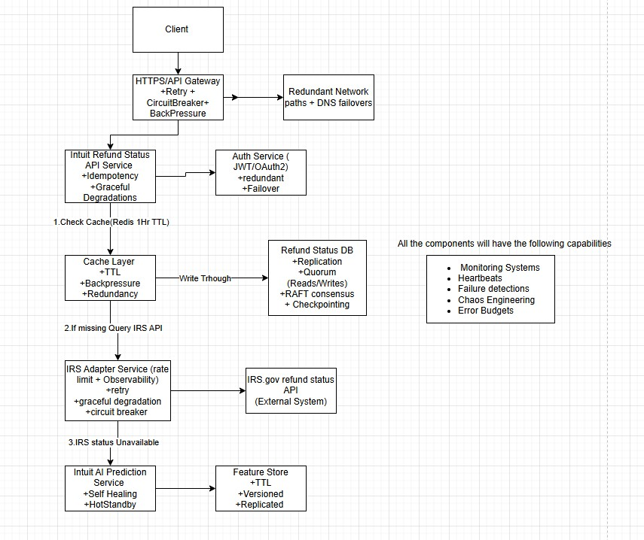
High-Level Architecture

Slide 7
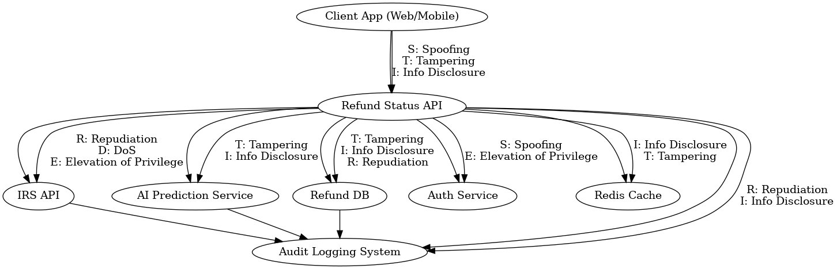
Challenge1:Data Privacy and Security-Deepdive
STRIDE threat model, encryption, OAuth, zero trust.

Slide 8
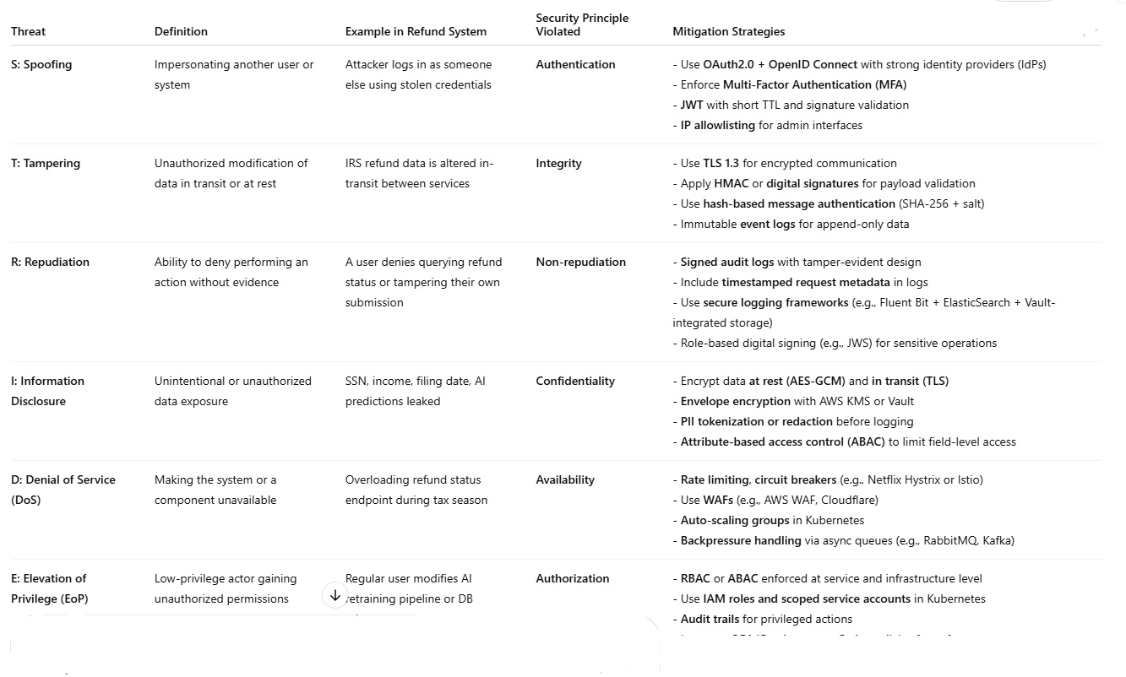
Threat model to Refund Tracker

Slide 9
Data privacy & Security
API Gateway
Spoofing risk → enforce MFA and token-based auth
Tampering risk → sign tokens and validate with public key
Rate-limit to prevent DoS
AI Prediction Service
Info disclosure → redact PII before passing to model
Repudiation → store signed inference logs
EoP → restrict model retraining to CI/CD jobs only

Slide 10
Data privacy & Security
PostgreSQL / Redis
Encrypt SSN using AES-GCM with IV rotation
Store KMS key material outside the app layer (e.g., HashiCorp Vault)
Apply row-level security + audit logging
IRS Integration Service
Tampering → TLS 1.3 & response signature validation
DoS fallback → queue IRS lookups, with retries and exponential backoff
Info disclosure → redact IRS response before logging
Tools: Microsoft Threat Modeling Tool, OWASP Threat Dragon, IriusRisk
Best Practice: Build threat modeling into CI/CD with DevSecOps gates
Documentation: Store threat matrix in Git as code (Markdown, YAML)

Slide 11
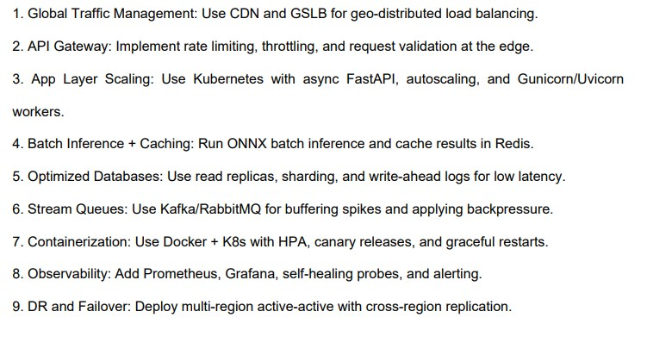
Challenge 2: High Season Traffic Scaling up Strategies

Slide 12
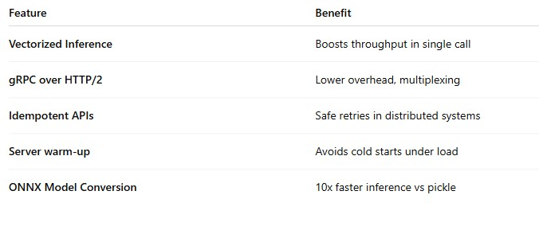
Scaling up Techniques

Slide 13
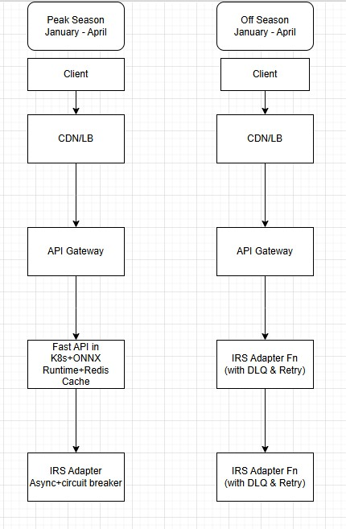
Peak-Off Peak Architecture

Slide 14
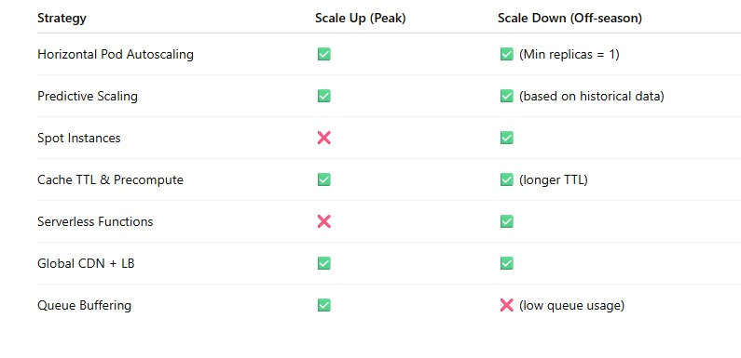
Scale Up & Scale Down

Slide 15
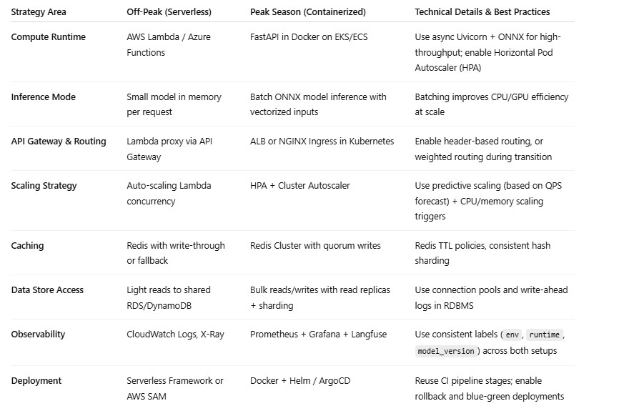
Switchover Strategies (Peak/OffPeak)

Slide 16
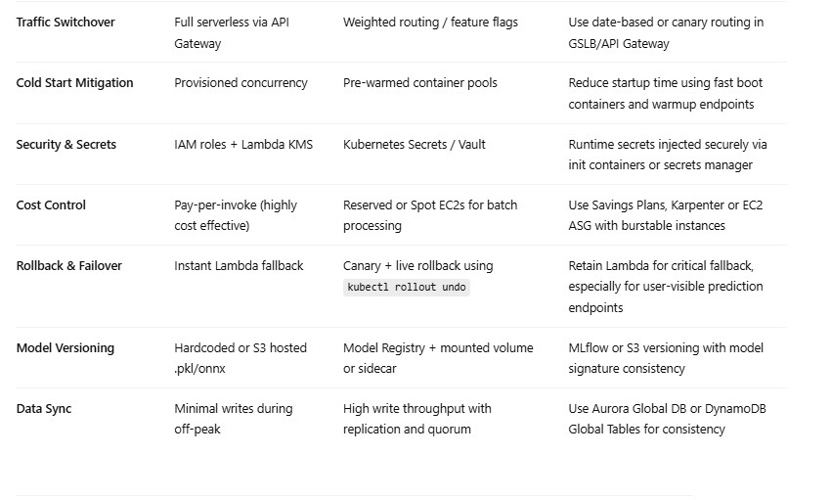
Switchover Strategies(Peak/OffPeak) Contd.

Slide 17
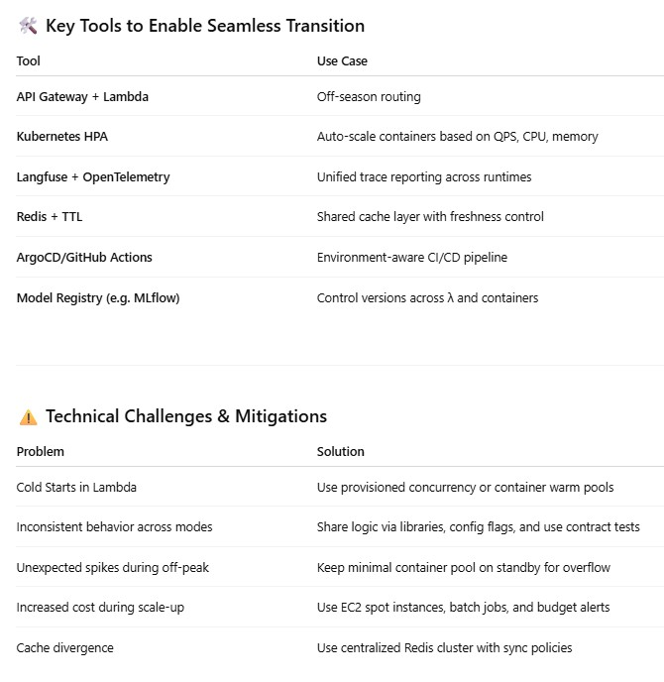

Slide 18
AI Pipeline
- ONNX inference service
- Features: income, filing date
- Retraining pipeline
- Confidence threshold alerts

Slide 19
AI Integration
1. Data Gathering- Sources: IRS logs, internal filing data, public IRS stats- Fields: filing date, income, refund amount, e-file flag, state, complexity- PII is masked/tokenized.
2. Feature Engineering- Features: filing method, amount, day-of-year, state- Target: days-to-refund (regression)- Categorical encoding and binning used.
3. Modeling & Hosting- Model: XGBoost or LightGBM with SHAP explanations- Hosting: FastAPI + ONNX

Slide 20
AI Integration
4.Data Pipeline Airflow or Step Functions → S3/Glue → Feature Store (Feast) → Model Training → Registry → EKS Deployment
5.Model training: XGBoost or LightGBM in Python Tracking + Ops: MLflow or Weights & Biases Deployment: Convert model to ONNX, serve with FastAPI + ONNX Runtime
6.Data Refresh & Retraining- Retrain nightly with fresh refund outcomes- Feedback loop to capture real refund dates- Trigger retrain if drift or error threshold is breached.
7.Accuracy & Drift- Metrics: RMSE < 3d, MAE < 2d, coverage > 85%
- Tools: Evidently, Langfuze for drift- Feedback-triggered retraining strategy

Slide 21
AI Integration
8. Bias Detection- Run Aequitas, Fairlearn on groups (state, income)- Use adversarial debiasing or reweighting if needed- Report disparities and ensure calibration.
9. Monitoring & Feedback- Metrics: latency, drift, low confidence alerts- Dashboards: Grafana + Langfuse/Prometheus- Alert thresholds on latency, error, and feedback discrepancy.
10. Security & Trust- Encrypt PII (AES + TLS)- Role-based access (ABAC/RBAC)- Auditable logs of inferences- Only expose non-sensitive fields to model

Slide 22
Q&A

